Slide 1
CRM Online International Launch Channel Partner Operations Training
Trainer Name:
Date:

Slide 2
Agenda
Module 1
Introduction
Module 2
Purchasing and Activating CRM Online
Module 3
Order Validation
Module 4
Escalations
Appendices
Useful Links/Notification

Slide 3
Objectives
At the end of this training you will be able to:
Describe the CRM Online offering
Validate CRM Online Orders
Explain the CRM Online Purchasing and Activation process

Slide 4
Module 1 - Introduction
What is CRM?
What is CRM Online?
Where is CRM been made available?

Slide 5





What is CRM?
Suitable for small business, midsized companies, and large enterprises.
Provides a complete suite of marketing, sales, and service capabilities.
Shares a consistent user experience based on Microsoft Office and Outlook.
A Customer Relationship Management solution.
What is CRM?

Slide 6



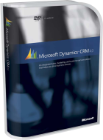
What is CRM Online?
Now 1st February 2011
Traditional Client-Server Solution
Online Services “Cloud” Solution
CRM “On-Premise” SKUs
Purchase License for current product version of Microsoft Dynamics CRM
CRM “Online” SKUs
Access the latest version of Microsoft Dynamics CRM online in all regions (Asia, EMEA & Latin America)
Currently already available in North America (Q2FY10)

Slide 7
Value Proposition
Deploying CRM Online through Microsoft Dynamics Online enables businesses to:
Reduce the burden on your IT staff and minimise your costs
Rapid, affordable, and streamlined way to implement Microsoft Dynamics CRM functionality.
Pilot it online before you bring it in-house

Slide 8
CRM Online SKUs Availability
Region
Volume Licensing Program
Enterprise Agreement (EA, EAS, Government)
Launched in North America (US & Canada) only in Q2FY10
Customer Type
New online Microsoft CRM Customers
Existing on-premise Microsoft CRM Customers
Launching now in various countries in Asia, EMEA and Latin America
CASA agreement (Including Enrolment for Education Solution (EES) and School Enrolment)
CASA will remain as is in Japan

Slide 9
CRM Online SKUs Availability – New Countries
With this release CRM Online will be available in the following countries:
ASIA
EMEA
Latin America
Austria,
Belgium
Cyprus (Southern),
Czech Republic,
Denmark,
Finland,
France,
Germany,
Greece,
Hungary,
Ireland,
Israel,
Italy,
Luxembourg,
Netherlands,
Norway,
Poland
Portugal,
Romania,
Spain,
Sweden,
Switzerland,
United Kingdom
Australia,
Hong Kong, India,
Japan,
Malaysia,
New Zealand, Singapore
Brazil,
Chile, Columbia, Costa Rica, Mexico,
Peru,
Puerto Rico, Trinidad & Tobago

Slide 10
Test your knowledge
Describe the main difference between CRM On-Premise and CRM Online.
Describe the 3 key points of the CRM Online Value Proposition.
Which Volume Licensing customers will be able to order CRM Online?
When and where will CRM Online become available?

Slide 11
Key Points
CRM Online is orderable Internationally from February 1st 2011
SKUs can be purchased under EA & CASA agreement (Including Enrolment for Education Solution (EES) and School Enrolment).
Available in North America since Q2FY10.
Now available in Asia, EMEA and Latin America with this launch

Slide 12
Module 2 – Purchasing & Activating CRM Online
Purchase & Activation Process

Slide 13
Purchase & Activation Process Overview
Customer signs up and Activates Trial
Partner submits the Purchase Order on behalf of the customer
Customer converts Trial to Subscription
Note:
All customers must trial the CRM Online service before purchasing the full CRM Online Service.
And
A customer can subscribe to a paid offer before the end of the 30 day trial

Slide 14
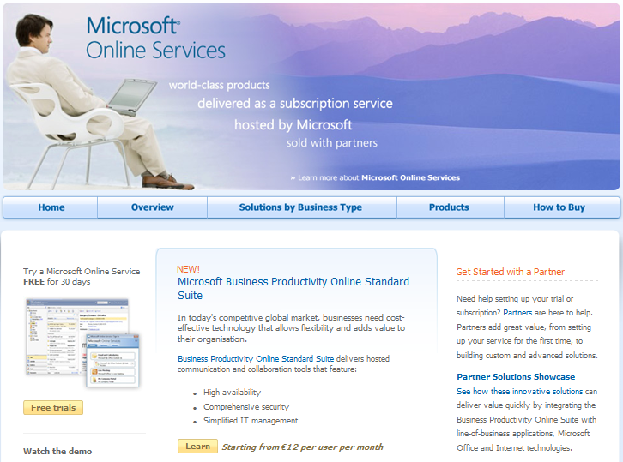
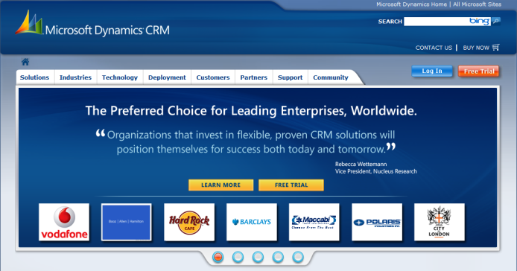

Sign-Up and Activate Trial
Customer signs up and Activates Trial
Customer converts Trial to Subscription
Partner submits Purchase Order
Customers sign-up on http://crm.dynamics.com or http://www.microsoft.com/online for a 30 day Trial.

Slide 15
Submit Purchase Order
Customer signs up and Activates Trial
Partner submits Purchase Order
Customer converts Trial to Subscription
Partner submits the order under an EA or CASA Agreement.
Subscriptions are Coterminous only.
SKU | Name | Description
DSD-00001 DSD-00010 | DynCRMOnln ALNG SubsVL MVL PerUsr DynCRMOnln ALNG SubsVL MVL Promo PerUsr | For customers who do not have any prior CRM on-premise purchases
DSD-00002 DSD-00012 | DynCRMOnln ALNG SubsVL MVL PerUsr forSA DynCRMOnln ALNG SubsVL MVL Promo PerUsr forSA | For customers who already have CRM on-premise purchases
DSD-00003 | DynCRMOnln ALNG SubsVL MVL AddOn XtraStorage | For extra storage purchases only

Slide 16
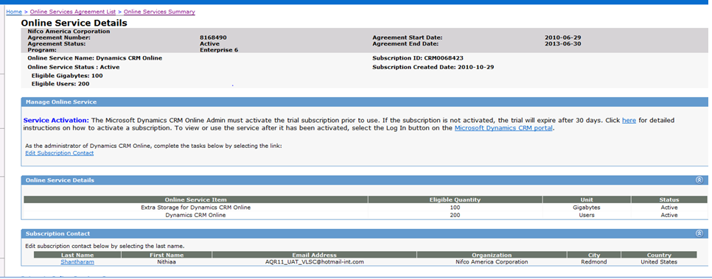
VLSC - CRM activation Link
Customers in VLSC can access the tool directly
The Microsoft Dynamics CRM Online admin must activate the trial subscription prior to use
If the subscription is not activated the trial expires after 30 days.
Click the link on screen to activate the subscription
this bring you directly to the CRM portal

Slide 17
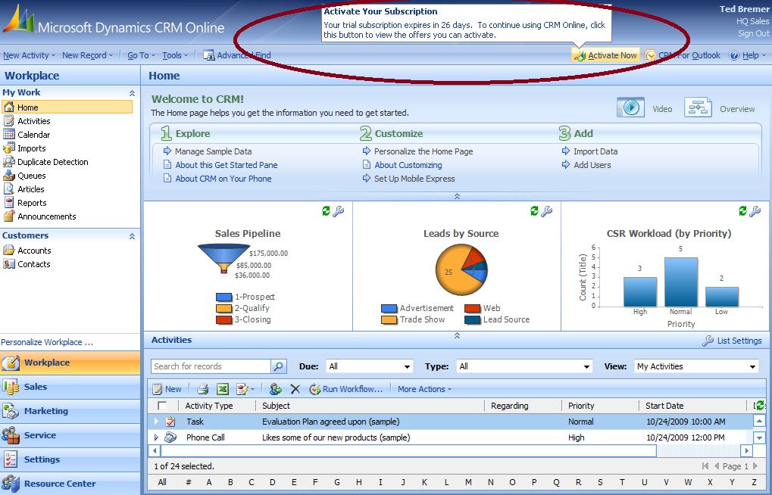
Convert Trial to Subscription
Customer signs up and Activates Trial
Partner submits Purchase Order
Customer converts Trial to Subscription
The Customer Converts their Trial to Subscription:
Follow the Instructions in the Activation email
- Or -
2) Click on the Activate Button in the CRM Application.

Slide 18
Customer Activates the Subscription
Assumptions:
Customer has purchased CRM and is looking to activate their service
Customer has signed up for a trial and is partially through their Trial period

Slide 19
Activating the subscription
Step 1: Customer clicks on the link within the email and logs into their CRM Online account (with their WLID)
Step 2: Customer chooses Enterprise Agreement option (Note: the system automatically defaults this option) and clicks “Next”
Step 3: Review and Accept the Subscription Terms. Click “I accept”
Step 4: Customer enters their contact information and clicks “Next”
Step 5: Customer enters quantities for users, that need to be activated
(Click Purchase)
Step 6: The Summary page is displayed where the customer can view their activation details
The customer receives an activation email with details on how to activate their subscription
Note that throughout the activation process references are made to purchase which aligns to activation.
Customer receives a
confirmation email confirming that the subscription has been activated.

Slide 20

Customer receives email to activate subscription
Owner –
Customer
Thank you for your recent subscription request for Microsoft Dynamics CRM Online. Below you will find the instructions necessary to activate your subscription with the special terms now available to your organization. You MUST activate this subscription before your trial term expires to take advantage of these terms.
Activation instructions:
1. Click here or enter the following web address in your Internet browser to activate your subscription:
http://go.microsoft.com/fwlink/?LinkID= 195570 [BY DATA CENTER]
• For security purposes, you will be asked to sign-out and re-sign into Microsoft Dynamics CRM Online during this step.
Follow the simple steps in the activation wizard to complete the process.
VOLUME LICENSING CUSTOMERS: If you acquired your Microsoft Dynamics CRM Online subscription via the Microsoft Volume Licensing program, someone in your organization (for example: purchasing department, licensing administration, information technology group, etc.) has purchased this subscription in a separate transaction. In order to complete the transaction, you MUST activate this subscription following the instructions above before your trial term expires.
The Microsoft Dynamics CRM Online Customer Service and Support group is available should you need any additional help. This includes access to our Microsoft Dynamics CRM Online product specialists, online community forums, detailed knowledge base articles and more. Customer Service and Support for Microsoft Dynamics CRM Online is available by contacting us at [CONTACT US LINK]
Sincerely,
The Microsoft Dynamics CRM Online Team

Slide 21
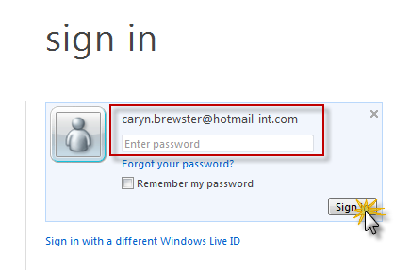
Customer Activates EA Subscription
Owner –
Customer
Step 1: Customer clicks on link and logs into their CRM Online account
The customer logs in using their Windows Live ID (WLID).
This should use the same WLID utilised during the trial.
Click the Sign In button

Slide 22
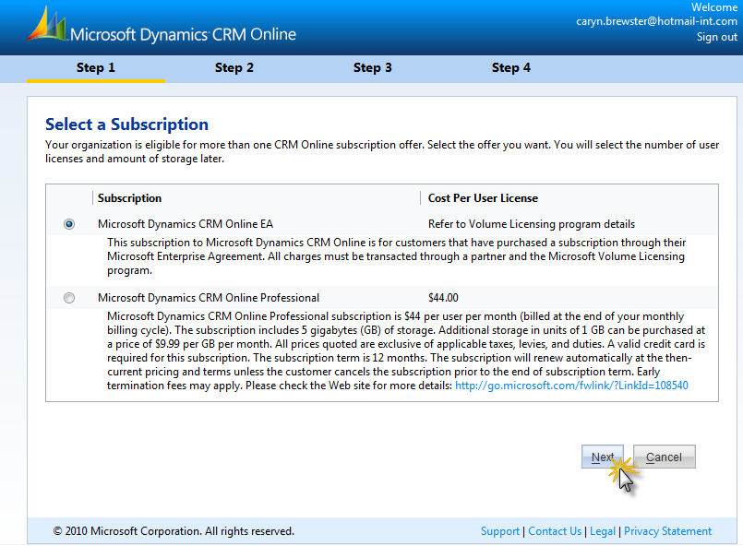
Customer Activates Paid Subscription
Owner –
Customer
Step 2: Customer chooses Enterprise Agreement option
(Note: the system automatically defaults this option)
Click “Next”

Slide 23
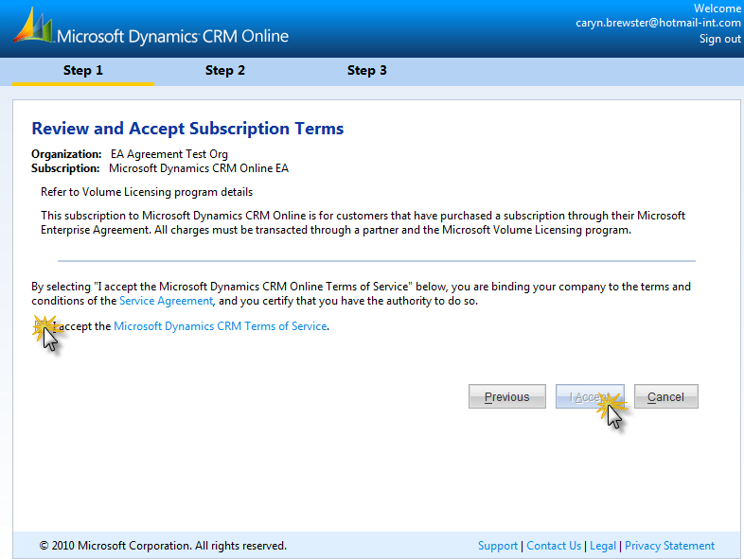

Customer Activates Paid Subscription
Owner –
Customer
Step 3: Review and Accept Subscription Terms
Description content will be updated based on offer text and will indicate EA
Click “I Accept”

Slide 24
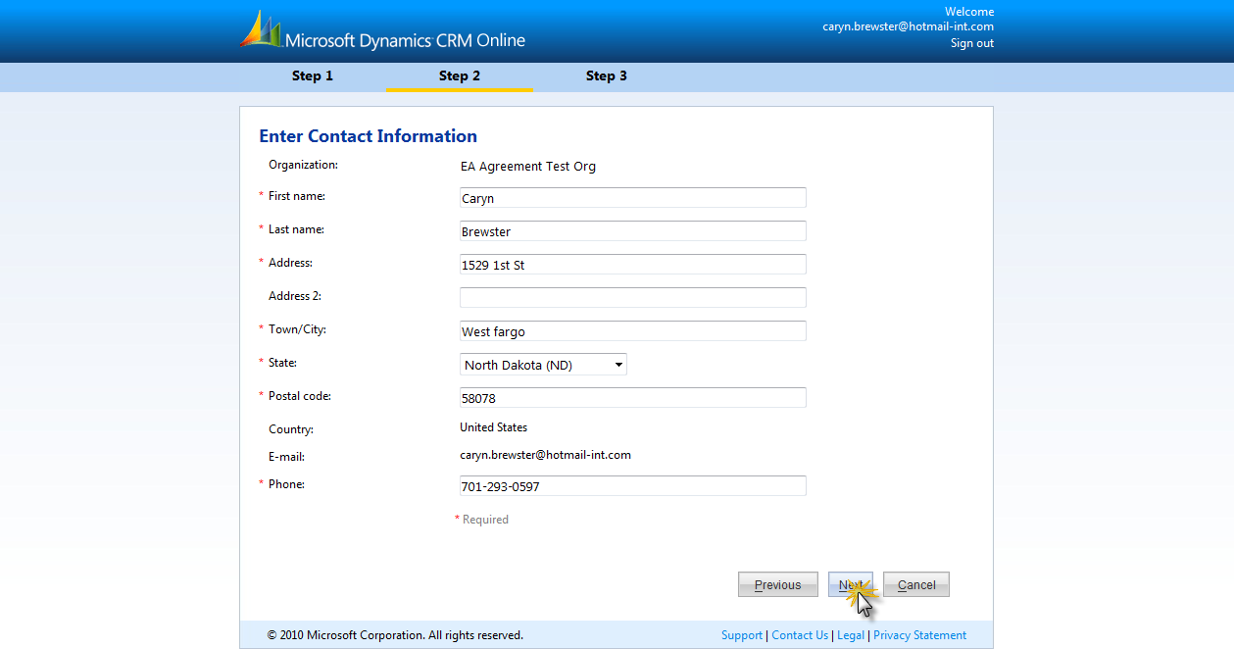
Customer Activates Paid Subscription
Owner –
Customer
Step 4: Customer enters contact information
Enter your contact information into this table
All compulsory items are visible by the red astrix *
Click Next to continue
Note: VAT ID will not be displayed for EA customers. Country / Language is already set based on trial information

Slide 25
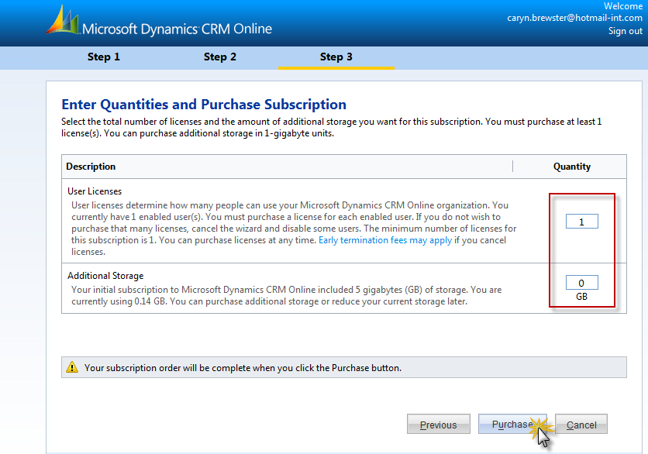
Customer Activates Paid Subscription
Owner –
Customer
Step 5: Enter quantities for users licenses and additional storage that requires activation. (Note: the system automatically defaults the user licenses to 1 and storage to 0)
10
1
2
“Purchasing” actually in this case refers to activation.
From here you are required to enter the number of activations required – note customer should only put in quantity of users they have purchased in License and Storage

Slide 26
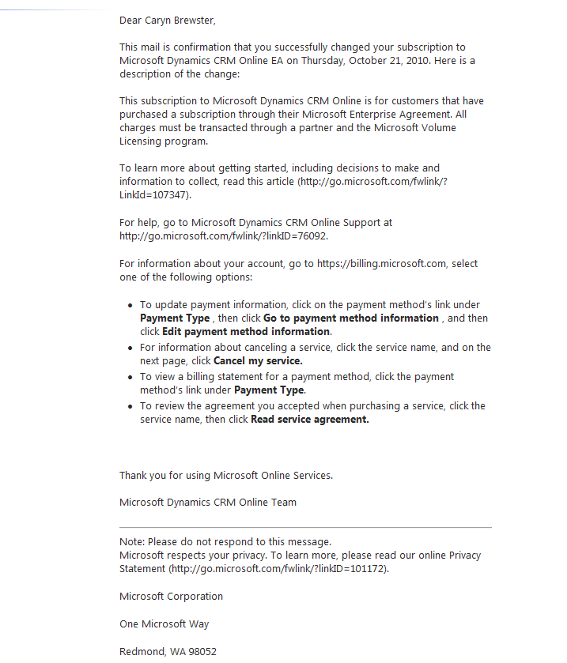
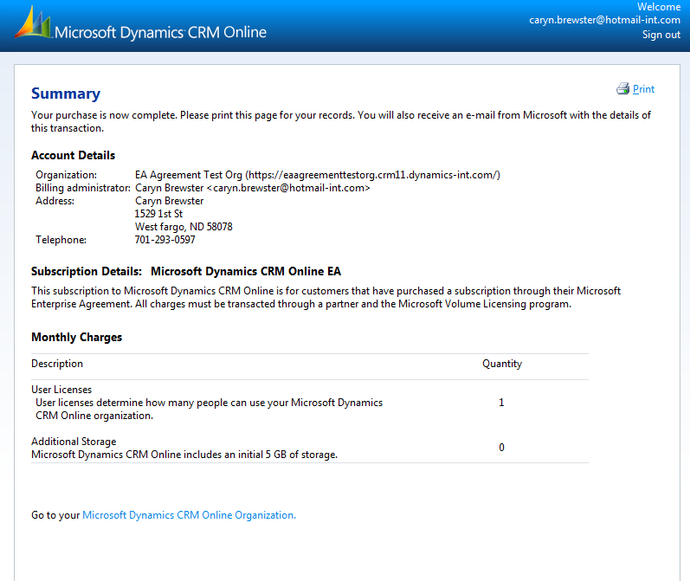
Customer Activates Paid Subscription
Owner –
Customer
Step 6: Summary page is displayed for the customer for their activation details
Step 7: Customer receives a confirmation email to confirm activation of subscription.

Slide 27

Support for Trial and Activation Queries
All customers who have signed up for CRM online: http://www.microsoft.com/dynamics/en/us/customersource.aspx
All EA and CASA partner queries:
Submit a query via CLT
Trial, activation and non-VL / MBS queries to”
APOC – mbslques
EOC – crmeoc;
AOC: https://mbs.microsoft.com/customersource/worldwide/us/contactus

Slide 28
Test your knowledge
What are the 3 steps to purchase and activate CRM Online?
What are the 3 types of CRM Online SKUs available?
What are the two ways to convert the Trial to a Subscription?

Slide 29
Key Points
3 steps to purchase CRM Online:
1. Customers sign-up for a 30 day Trial
2. Channel Partners place an order
3. Customers convert the Trial to a Subscription
CRM Online Subscriptions are Coterminous
SKUs available:
1. New Customers orders full/promo SKU
2. Existing Customers order discounted/promo SKU
3. CRM Online customers order Extra Storage

Slide 30
Module 3 – Order Submission & Escalations

Slide 31
CRM Online SKUs for EA & CASA
Customer does NOT have On-Premise Purchases
Partner orders the Full / Promo CRM Online SKU
Customer has On-Premise Purchases
Partner orders the Discounted/ Promo CRM Online SKU
Customer has CRM Online purchases
Partner orders the Extra Storage SKU

Slide 32
CRM Online SKUs for EA & CASA
Pre – requisite Order |  | CRM Online SKU | CRM Online SKU Description
N/A | N/A | DSD-00001 DSD-00010 | DynCRMOnln ALNG SubsVL MVL PerUsr DynCRMOnln ALNG SubsVL MVL Promo PerUsr
ZFA-00237 | DynCRMCAL ALNG LicSAPk MVL UsrCAL | DSD-00002 DSD-00012 | DynCRMOnln ALNG SubsVL MVL PerUsr forSA DynCRMOnln ALNG SubsVL MVL Promo PerUsr forSA
ZFA-00245 | DynCRMCAL ALNG LicSAPk MVL DvcCAL
QYA-00206 | DynCRMAddtvCAL ALNG LicSAPk MVL DvcCAL
QYA-00222 | DynCRMAddtvCAL ALNG LicSAPk MVL UsrCAL
ZFA-00221 | DynCRMCAL ALNG SA MVL UsrCAL
ZFA-00229 | DynCRMCAL ALNG SA MVL DvcCAL
QYA-00226 | DynCRMAddtvCAL ALNG SA MVL DvcCAL
QYA-00230 | DynCRMAddtvCAL ALNG SA MVL UsrCAL
DSD-00001 | DynCRMOnln ALNG SubsVL MVL PerUsr | DSD-00003 | DynCRMOnln ALNG SubsVL MVL AddOn XtraStorage
DSD-00002 | DynCRMOnln ALNG SubsVL MVL PerUsr forSA

Slide 33
Scenario
Customer with 100 On-Premise SKUs places orders for CRM Online SKUs
Year 1
Year 2
Year 3
Rule: Number of Online Discounted SKUs must be equal or less than On-Premise SKUs.
Month 2
CRM Online Discount SKU x 100
CRM Online Full SKU x 50
Rule: Customers can add additional users anytime (as long as the EA / CASA Agreement is active).
Month 6
CRM Online Full SKU x 20
Month 15
CRM Online Extra Storage SKU
Rule: CRM Online Customers can add Extra Storage anytime if they have previously purchased CRM Online.
All Orders end with the EA / CASA Agreement.

Slide 34
Escalation Process
Channel Partners – For EA and CASA queries
Tier 1 – Log a query through CLT
Tier 2 - Contact their Operations Account Manager (OAM)
All non EA and CASA queries
http://crm.dynamics.com

Slide 35
Test your knowledge
What is the pre-requisite to purchasing:
The CRM Online Discounted SKU?
The Extra Storage SKU?
True or False?
CRM Online Subscriptions are Coterminous only.

Slide 36
Key Points
Customers must already have On-Premise SKU with Software Assurance to purchase the discounted Online SKU
Quantity of discounted Online SKU
≤
Quantity of On-Premise SKU
Customers must have the Online SKU to purchase the Extra Storage SKU

Slide 37
Resources & Notifications
Appendix 1

Slide 38

Useful Links
http://crm.dynamics.com http://www.microsoft.com/online | Sign-up to the Microsoft Dynamics CRM Online Trial Information on Online Services
http://www.microsoft.com/dynamics/en/us/customersource.aspx http://crm.dynamics.com/support/crm-support-overview.aspx | Support for Trial and Activation Queries

